Slide 1
Data scientist vs Machine learning engineer
Data, their quality collection and their deeper understanding makes the difference between a good and a better machine learning programmer.

Slide 2
Data
A small introduction to classification
A small introduction to classification
Machine Learning Methods
Notes:
Ažurirati naziv kolegija.

Slide 3


Slide 6
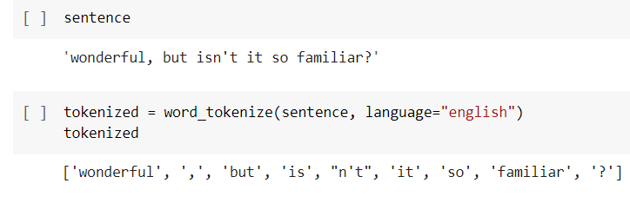
good | movie | not | a | did | like
1 | 1 | 0 | 0 | 0 | 0
1 | 1 | 1 | 1 | 0 | 0
0 | 0 | 1 | 0 | 1 | 1
good movie
not a good movie
did not like

Slide 7
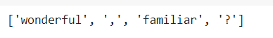

Slide 8
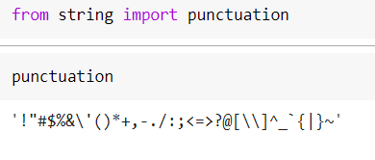
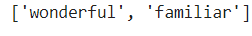

Slide 9
Stemming
game | historical | history | important
1 | 1 | 0 | 0
1 | 0 | 1 | 1
historical game
The most important game ih history
final
going
historical
histori
finally
fina
goes
go
history
finalized
gone

Slide 10
Lemmatisation
final
going
historical
history
finally
final
goes
go
history
finalized
gone
game | history | important
1 | 1 | 0
1 | 1 | 1
historical game
The most important game ih history

Slide 11
171476 number of words in Oxford dictionary

Slide 12
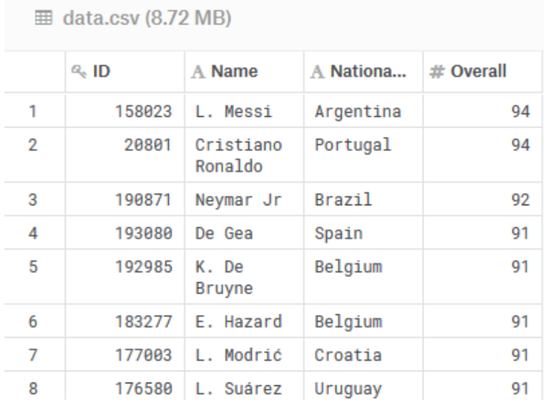
How can you know that the Nationality feature does not affect Overall? Maybe it is the Brazilian footballers who are deliberately given a bigger Overall than they deserve?

Slide 13


Slide 14
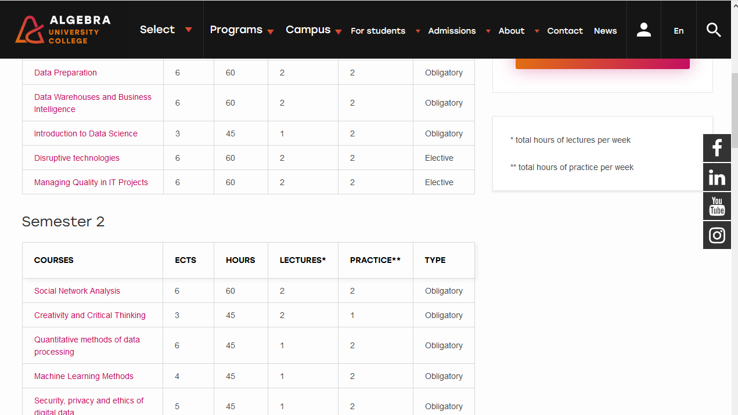

Slide 15
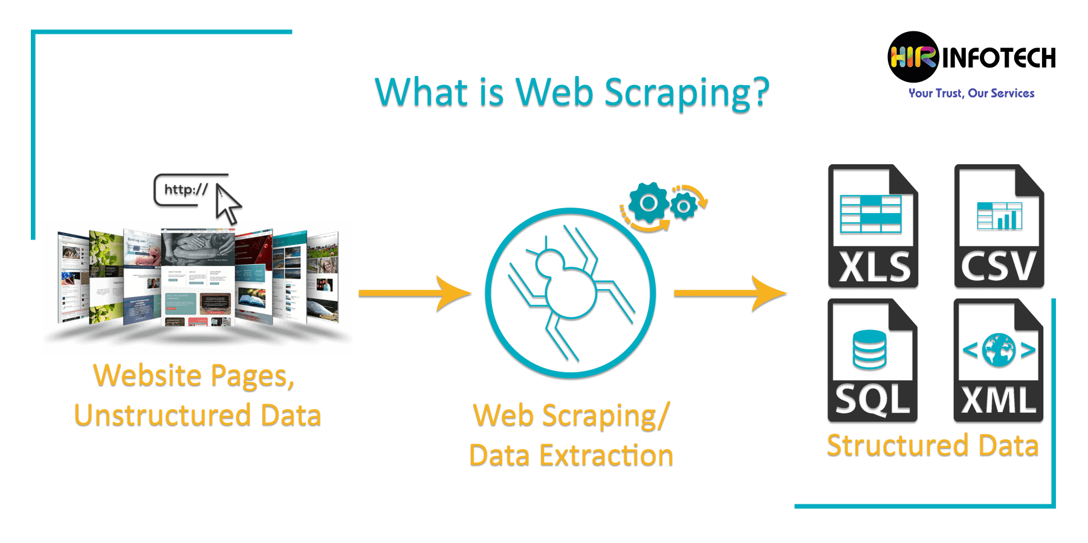

Slide 16
Idea behind Web Scraping
Use HTML code of web page
Parse HTML code
Put given data in .csv file
<table>
<tr>
<td>1</td> <td>2</td> <td>3</td>
</tr>
</table>
1 | 2 | 3

Slide 17
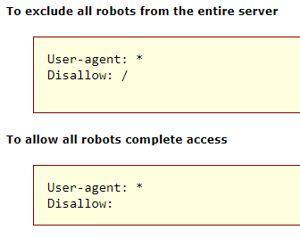
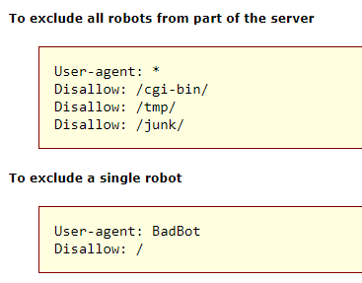
Website owners use this file to provide instructions about their site bots - Robot Exclusion Protocol
http://www.robotstxt.org/

Slide 18
Example
We want to exclude table from this web page https://www.hnb.hr/statistika/glavni-makroekonomski-indikatori

Slide 19
Problem
Many Machine Learning problems involve thousands or even millions of features for each training instance.
Not only does this make training extremely slow, it can also make it much harder to find a good solution.

Slide 20
Data in high dimensions and PCA
A small introduction to classification
A small introduction to classification
Machine Learning Methods
Notes:
Ažurirati naziv kolegija.

Slide 21
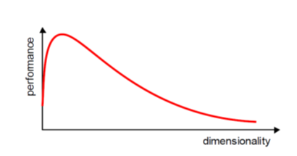
Problem

Slide 22
Dimensionality reduction
Feature selection

Slide 23

Dimensions $≠$ Number of features
y
1
0
f1 + f2 + f3 + f4

Slide 24
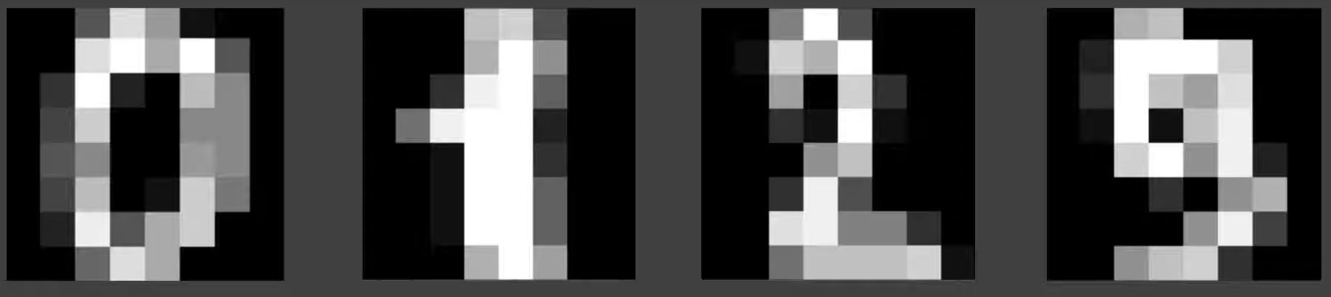

Slide 25
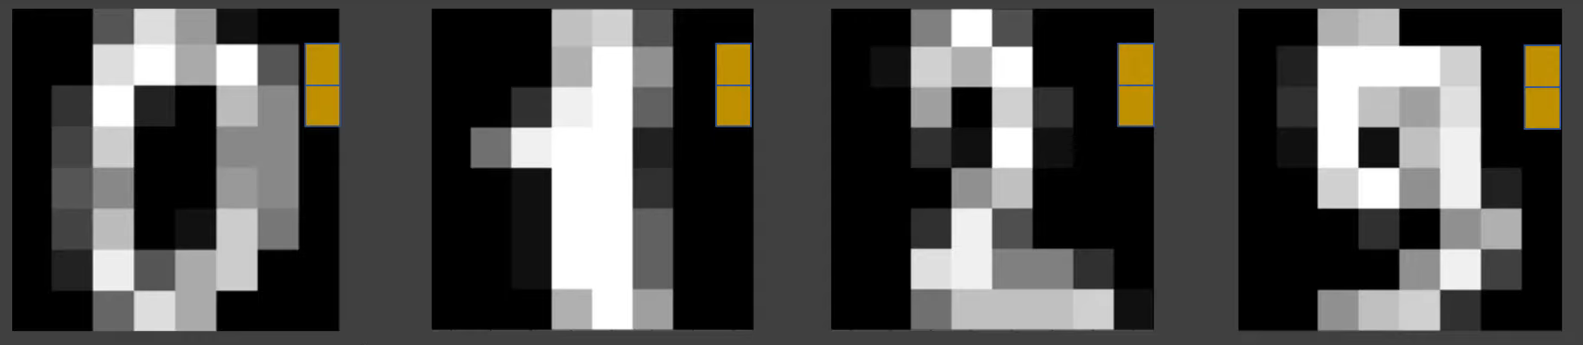

Slide 26
PCA
A more common way of speeding up a machine learning algorithm is by using Principal Component Analysis (PCA). If your learning algorithm is too slow because the input dimension is too high, then using PCA to speed it up can be a reasonable choice. This is probably the most common application of PCA.

Slide 27



Slide 28


Slide 29


Slide 30


Slide 31
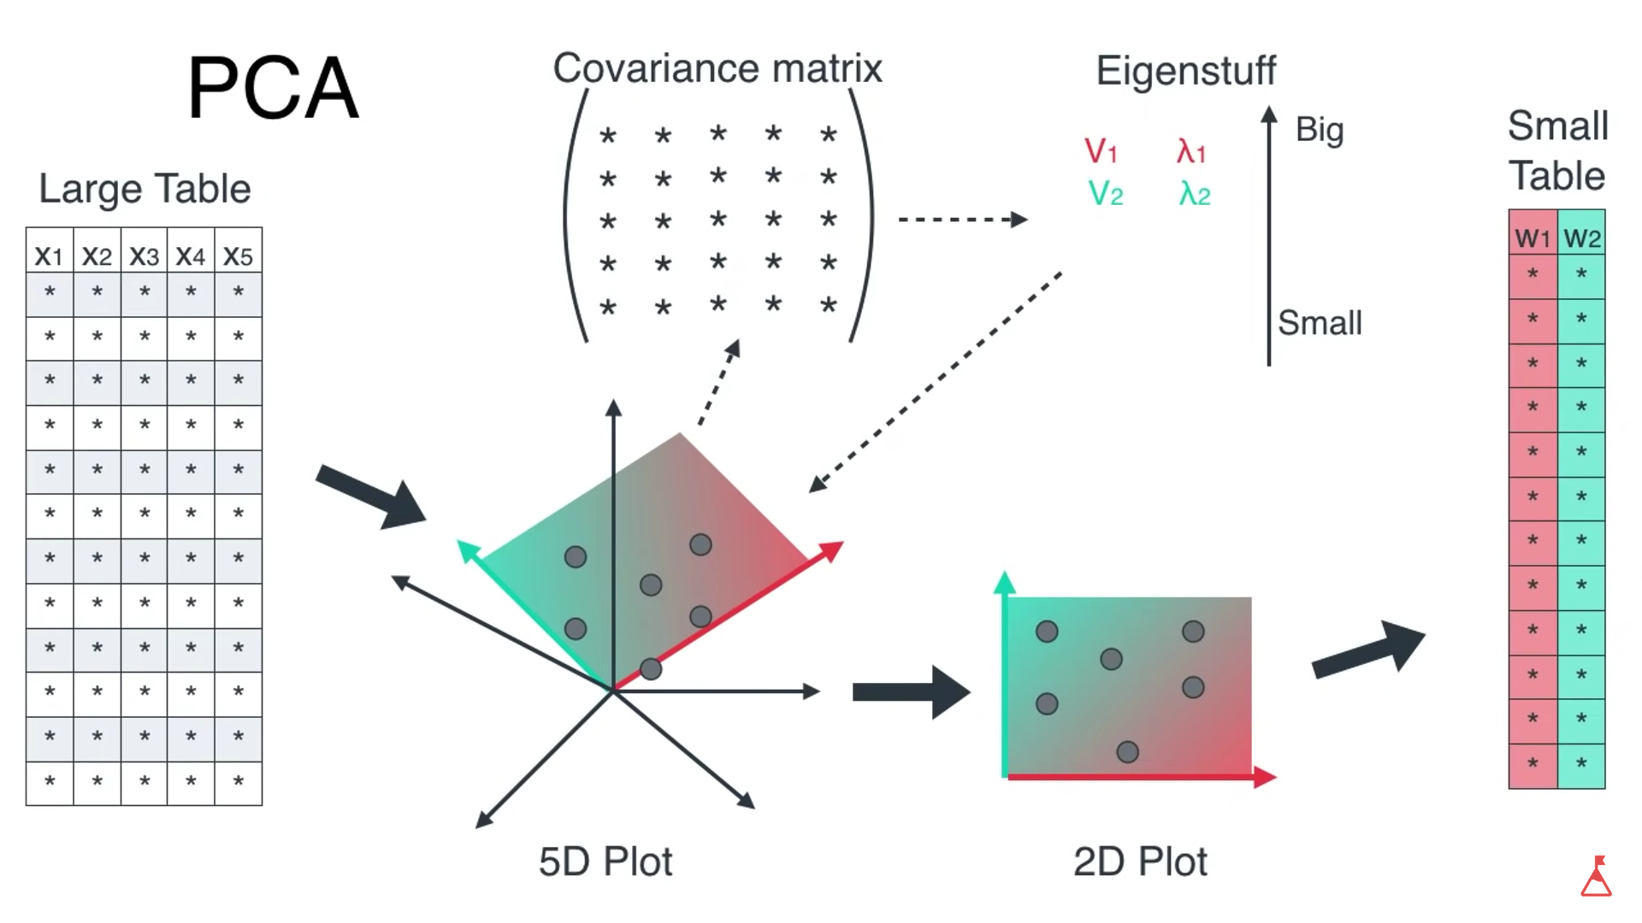

Slide 32
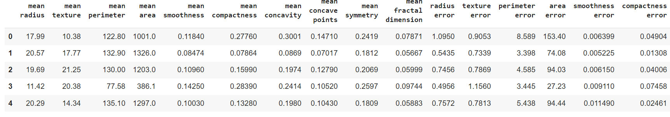
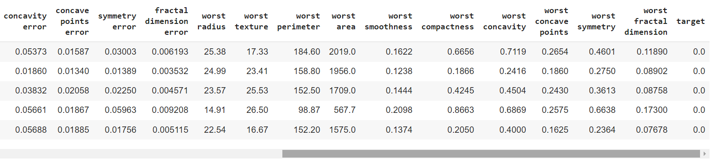
Example
dataset containing 569 examples
and 30 attributes, while the target variable is either 1 (malignant tumor) or 0 (benign tumor).

Slide 33
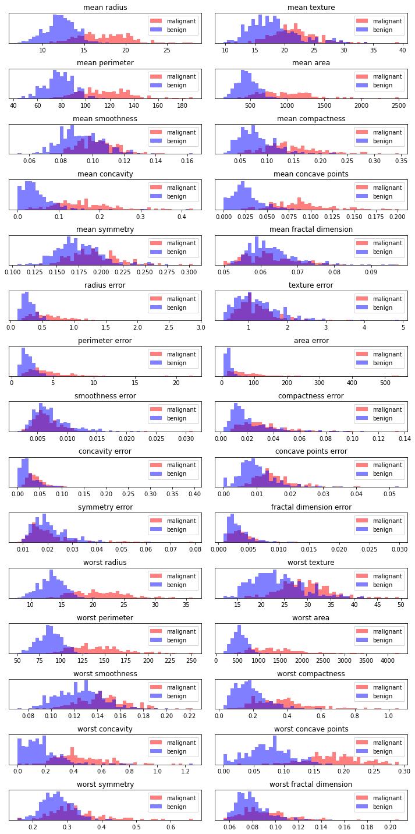

Slide 34
from sklearn.preprocessing import StandardScaler
from sklearn.decomposition import PCA
breast_cancer = pd.read_csv('breast_cancer.csv',index_col=0)
scaler = StandardScaler()
X = breast_cancer.drop('target',axis=1)
X_scaled = scaler.transform(X)
pca = PCA() # use option n_components=2 to calculate just first two principal components
pca.fit(X_scaled) # fit PCA model to breast cancer data
X_pca = pca.transform(X_scaled) # transform data onto the principal components
print("Dimensions of the original data: %s" % str(X_scaled.shape))
print("Dimensions of projected data: %s" % str(X_pca.shape))

Slide 35
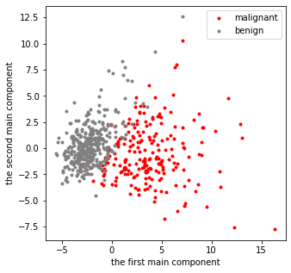

Slide 36
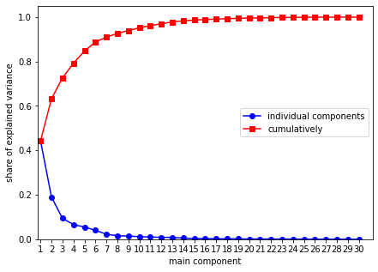

Slide 37
breast_cancer = pd.read_csv('breast_cancer.csv')
breast_cancer_train, breast_cancer_test = train_test_split(breast_cancer, test_size=0.30, random_state=39)
X_train = breast_cancer_train.drop('target',axis=1)
y_train = breast_cancer_train['target']
X_test = breast_cancer_test.drop('target',axis=1)
y_test = breast_cancer_test['target']
pipe = Pipeline(steps=[('scaler', StandardScaler()),
('pca', PCA()),
('logistic',LogisticRegression(solver='liblinear'))])
estimator = GridSearchCV(pipe,
dict(pca__n_components=range(1,10)),
cv=10,
scoring='accuracy')
model = estimator.fit(X_train, y_train)

Slide 38
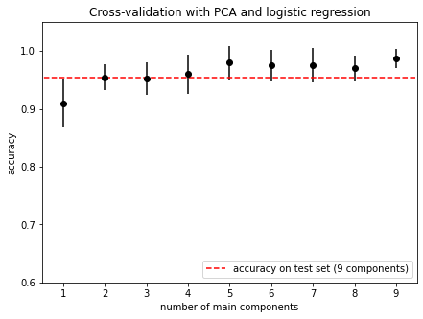

Slide 39
Data in high dimensions and PCA Example
A small introduction to classification
A small introduction to classification
Machine Learning Methods
Notes:
Ažurirati naziv kolegija.

Slide 40
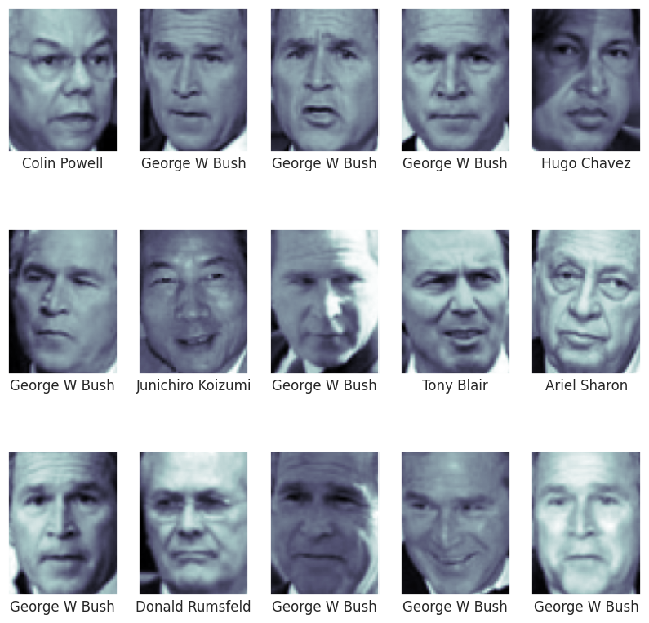

Slide 41
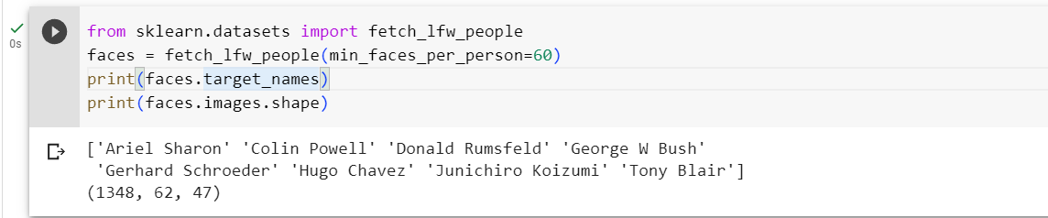

Slide 42
from sklearn.svm import SVC
from sklearn.decomposition import PCA
from sklearn.pipeline import make_pipeline
from sklearn.preprocessing import StandardScaler
ss = StandardScaler()
pca = PCA(n_components=150, random_state=42, svd_solver='randomized')
svc = SVC(kernel='rbf', class_weight='balanced')
model = make_pipeline(ss, pca, svc)
from sklearn.model_selection import train_test_split
Xtrain, Xtest, ytrain, ytest = train_test_split(faces.data, faces.target,
random_state=42, stratify=faces.target)

Slide 43
Thank you for your attention!

